Slide 1
QGIS In Practice
2017

Slide 2
AGENDA
Introduction
Data Loading
Plugins
Filter
Properties
Example

Slide 3


Introduction
Free & open source Geographic Information System
Quantum GIS since 2002
QGIS 2.0 release on June 2013
Latest version Las Palmas 2016
Multiple OS platform support

Slide 4

Data Loading
Vector
Raster
SQLite
PostGIS
CSV/Delimited Text File
……
Notes:
拉斯帕尔马斯
西班牙的城市

Slide 5
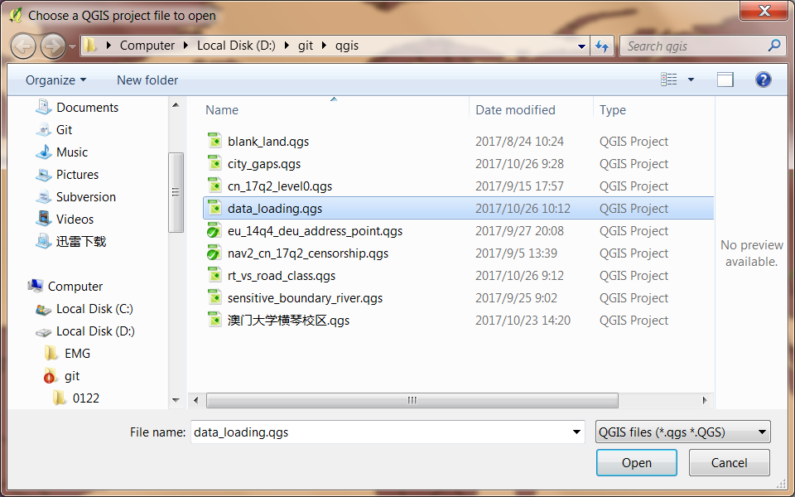
Data Loading – FROM GQIS FILE
Notes:
拉斯帕尔马斯
西班牙的城市

Slide 6
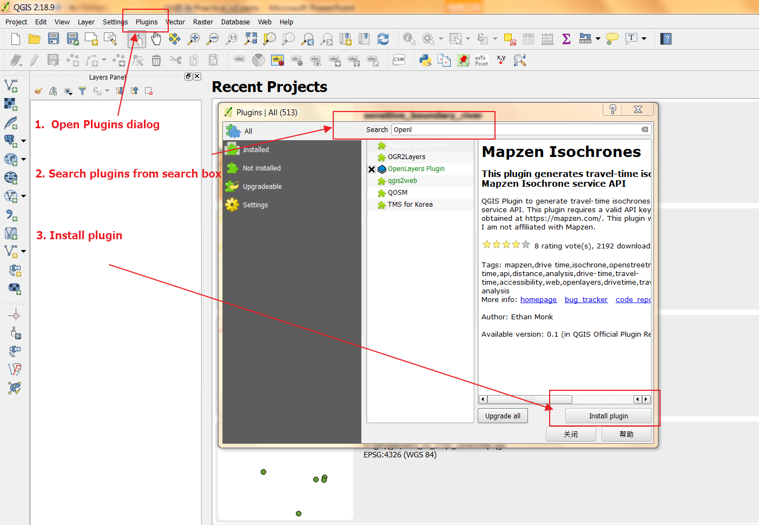
Plugins -- Installation

Slide 7
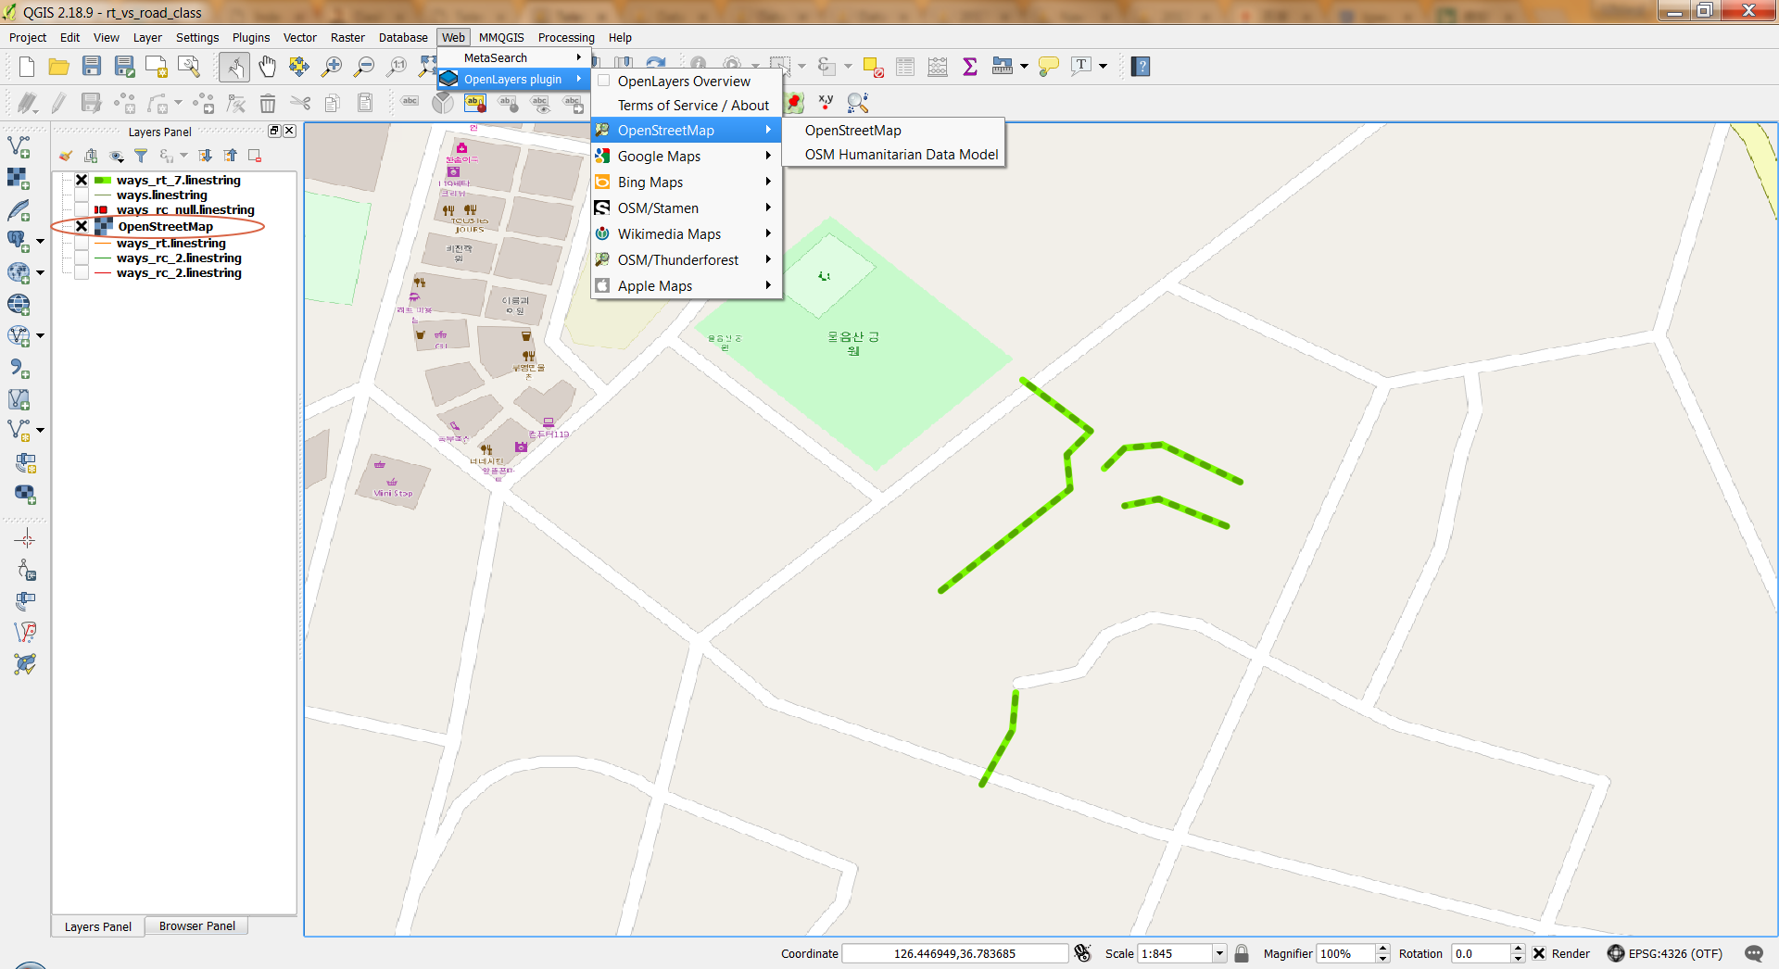
Plugins -- POPULARs
OpenLayers Plugin

Slide 8
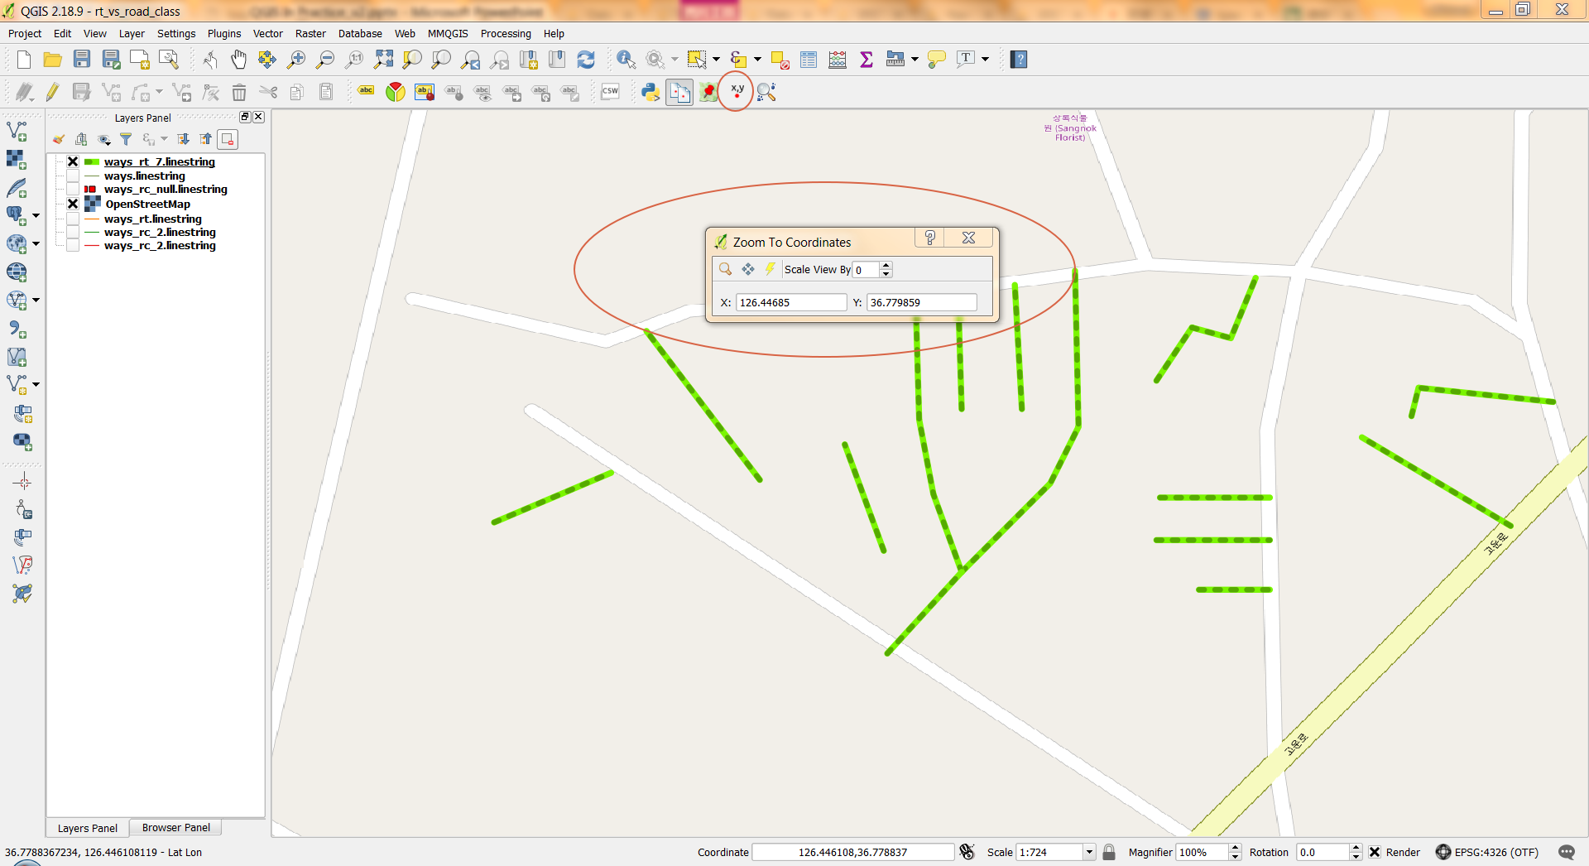
Plugins -- POPULARs
Zoom To Coordinates

Slide 9
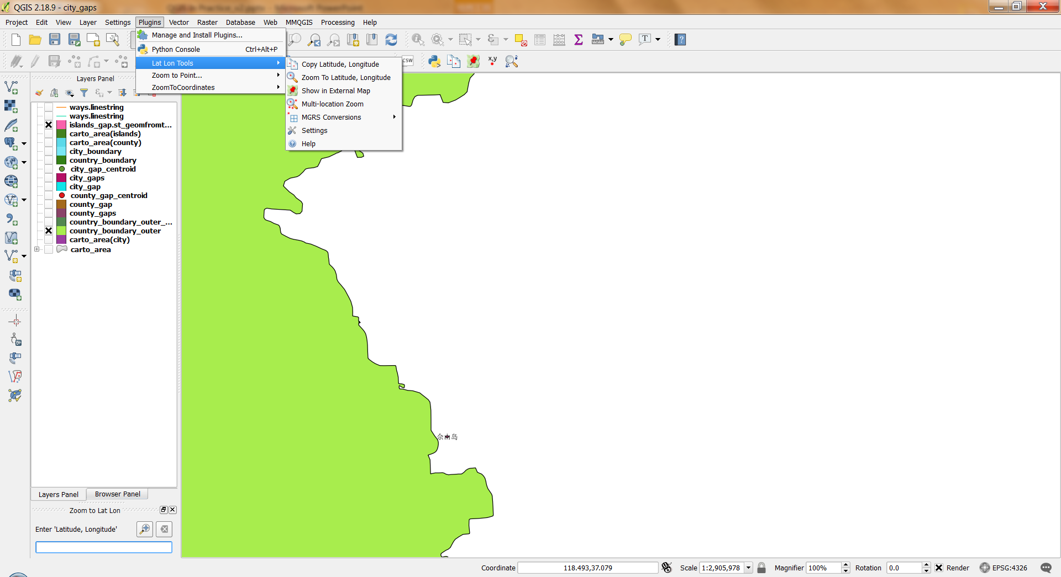
Plugins -- POPULARs
Lat Lon Tools

Slide 10
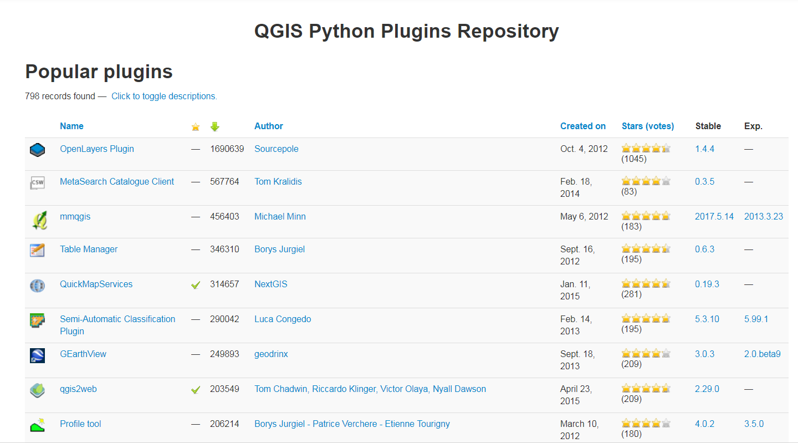
Plugins -- POPULARs
https://plugins.qgis.org/plugins/popular/

Slide 11
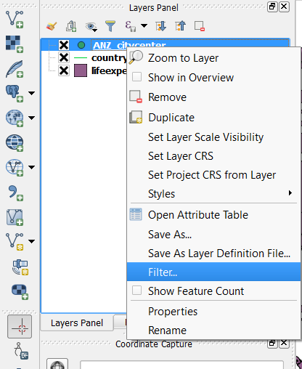
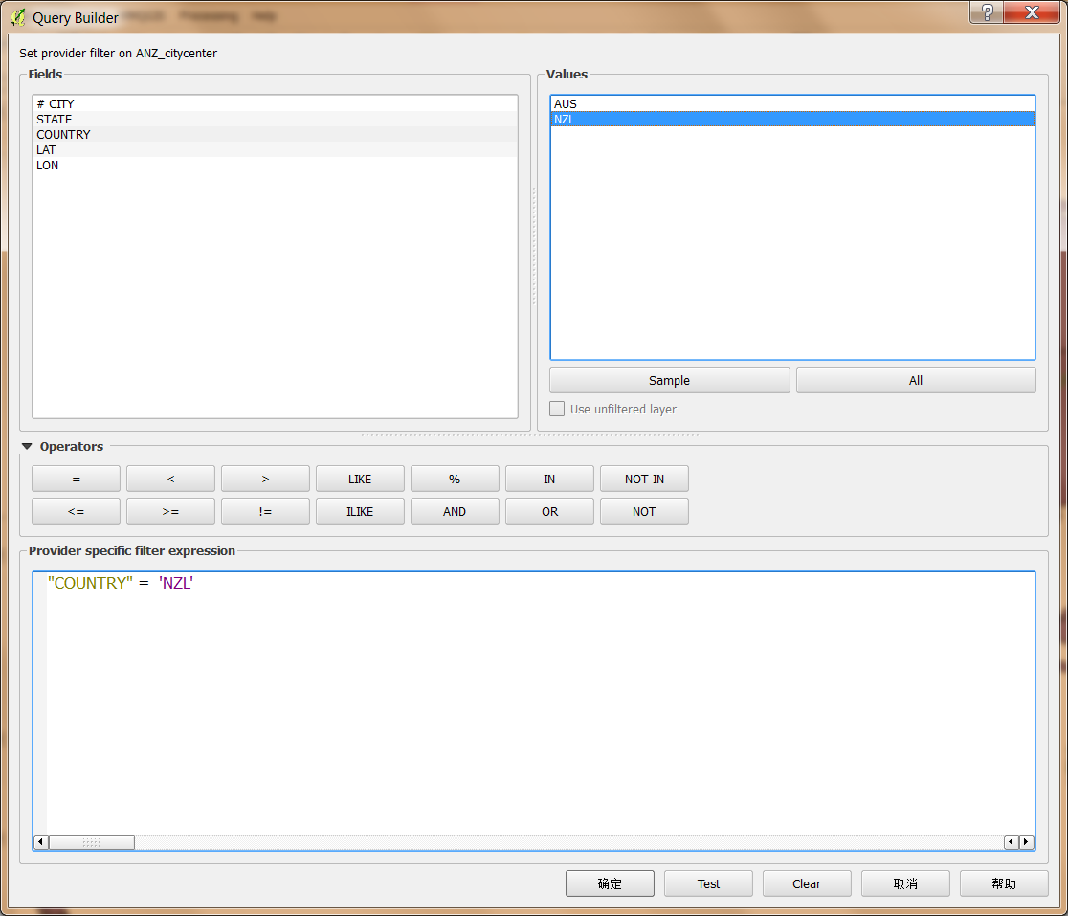
Filter
Filter target features
Improve render efficiency

Slide 12
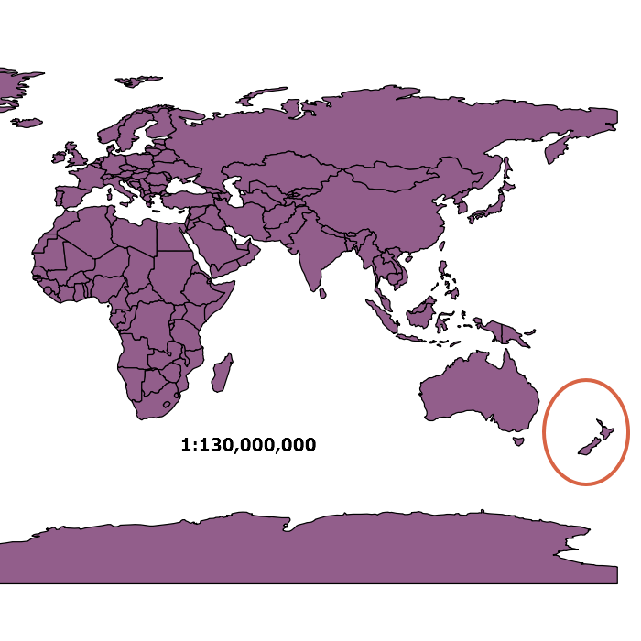
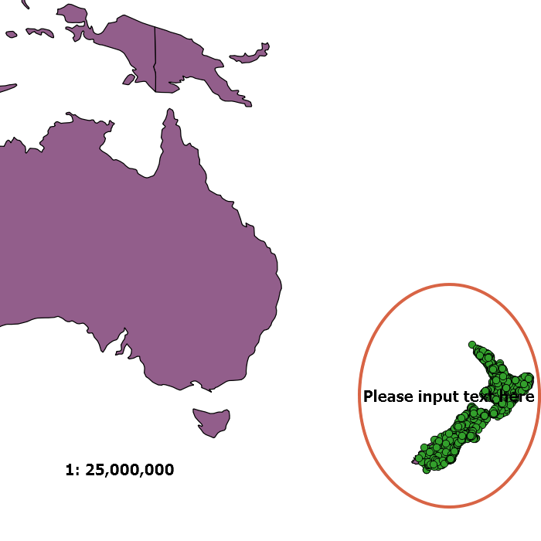
Properties – SCALE VISIBILITY

Slide 13
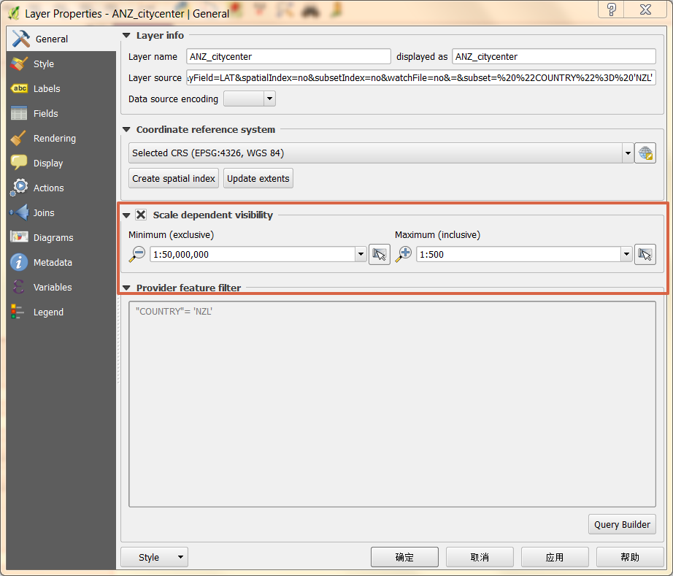
Properties – SCALE VISIBILITY

Slide 14
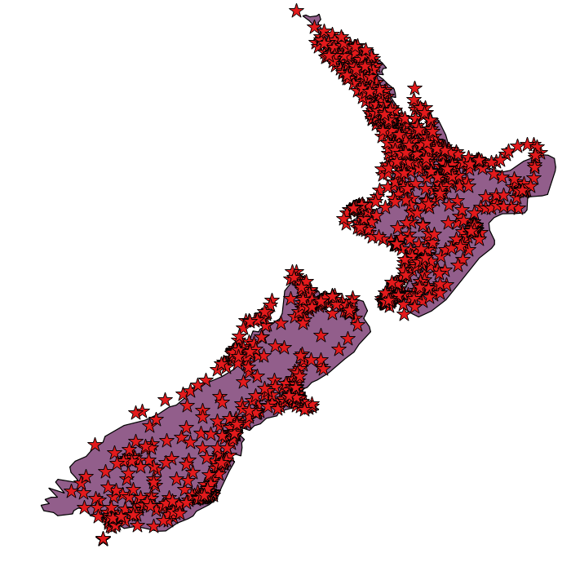
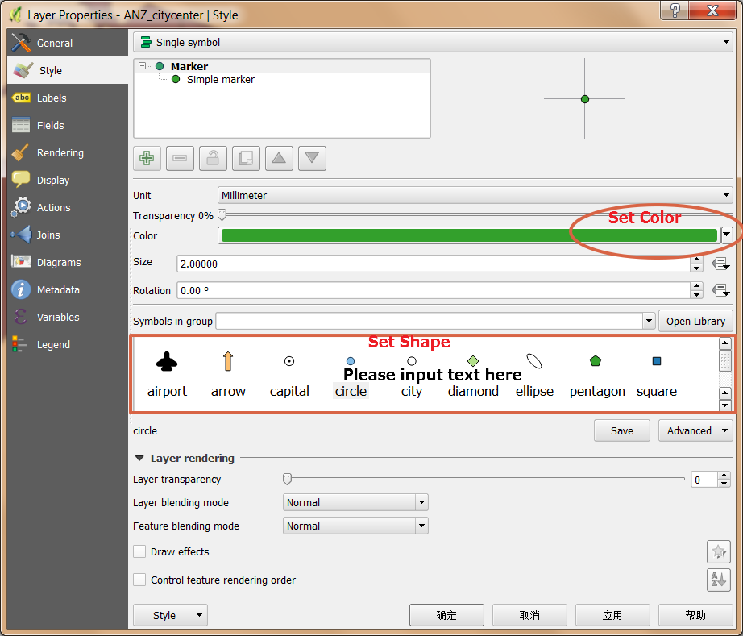
Properties – STYLE

Slide 15
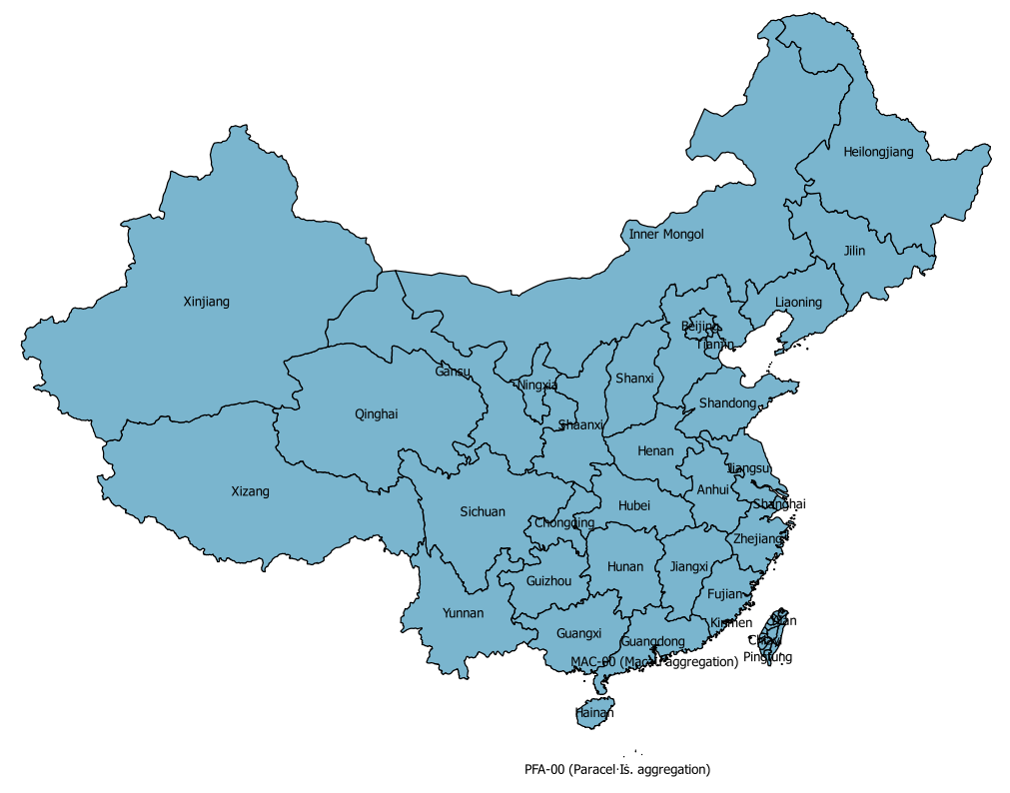
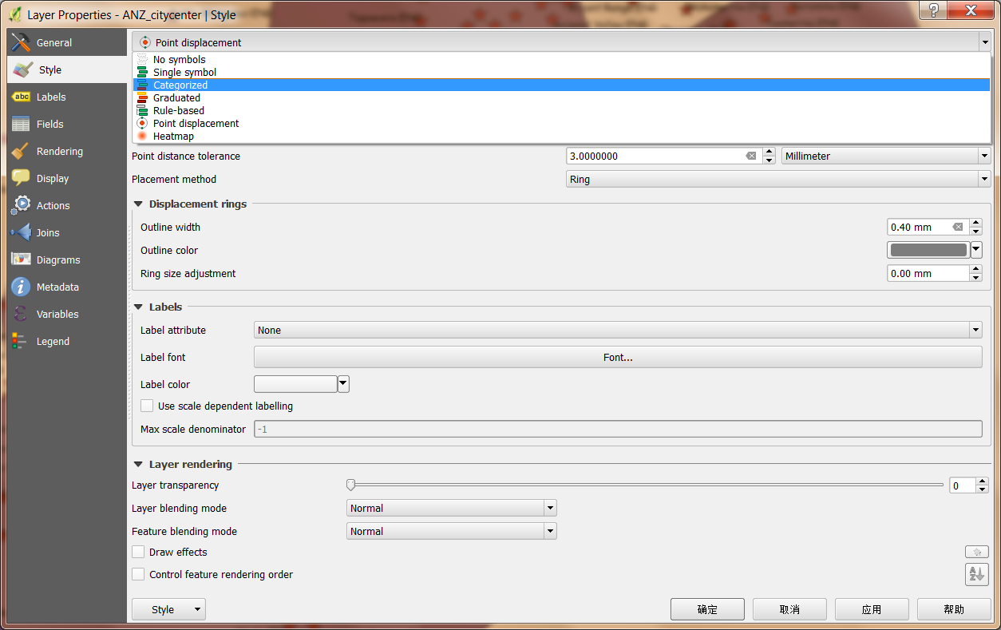
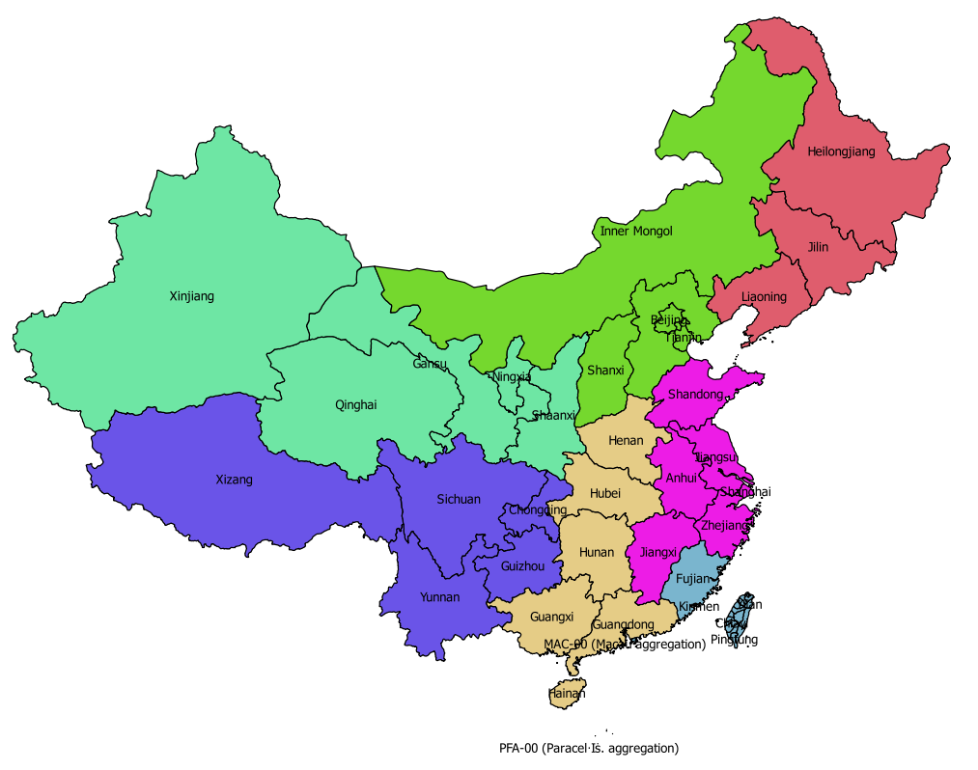
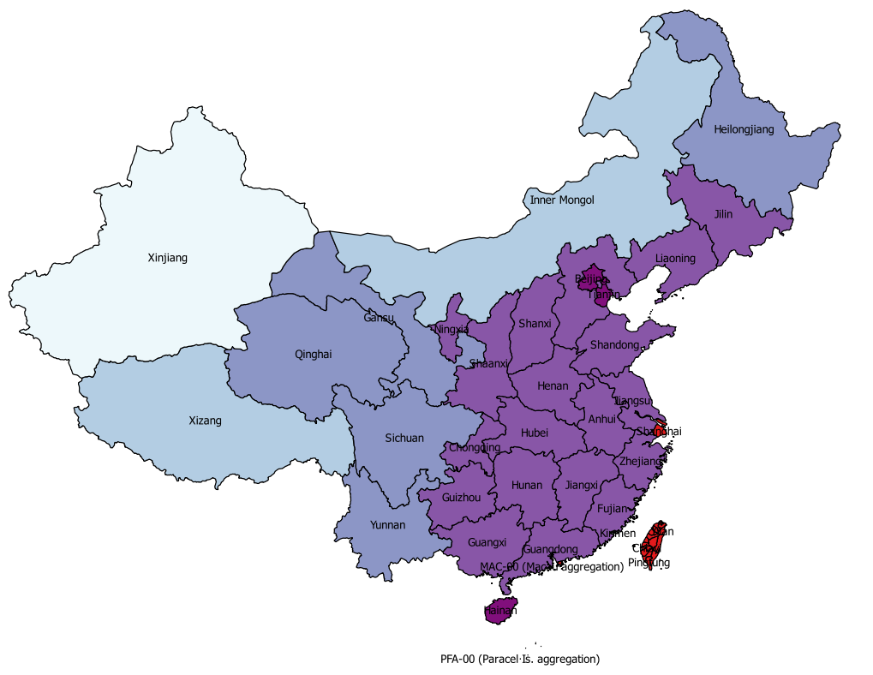
Properties – STYLE
Single Symbol
Categorized styles
Graduated styles

Slide 16
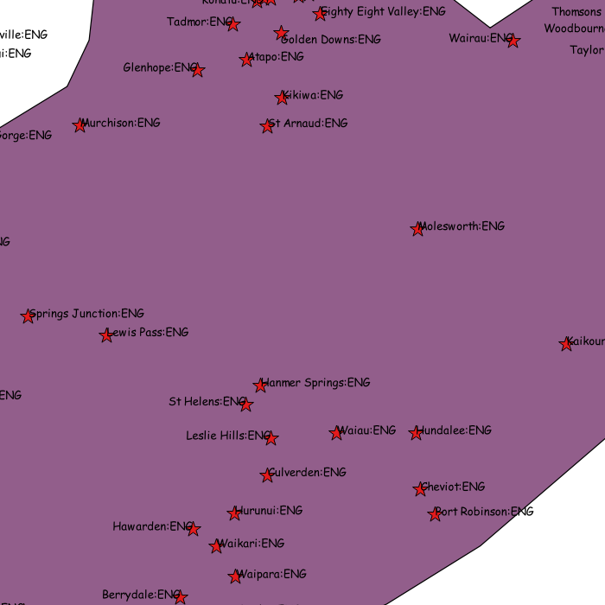
Properties – LABLE

Slide 17
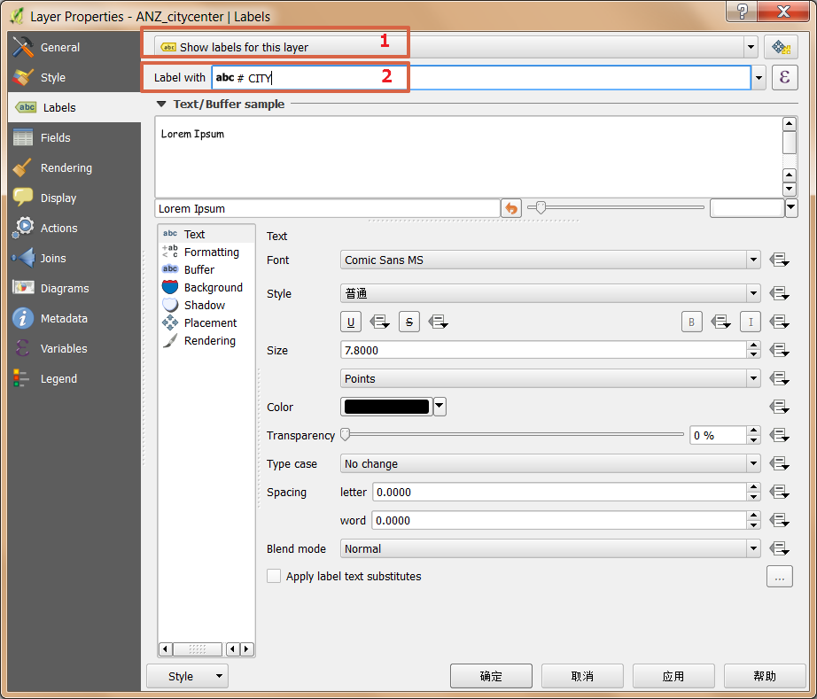
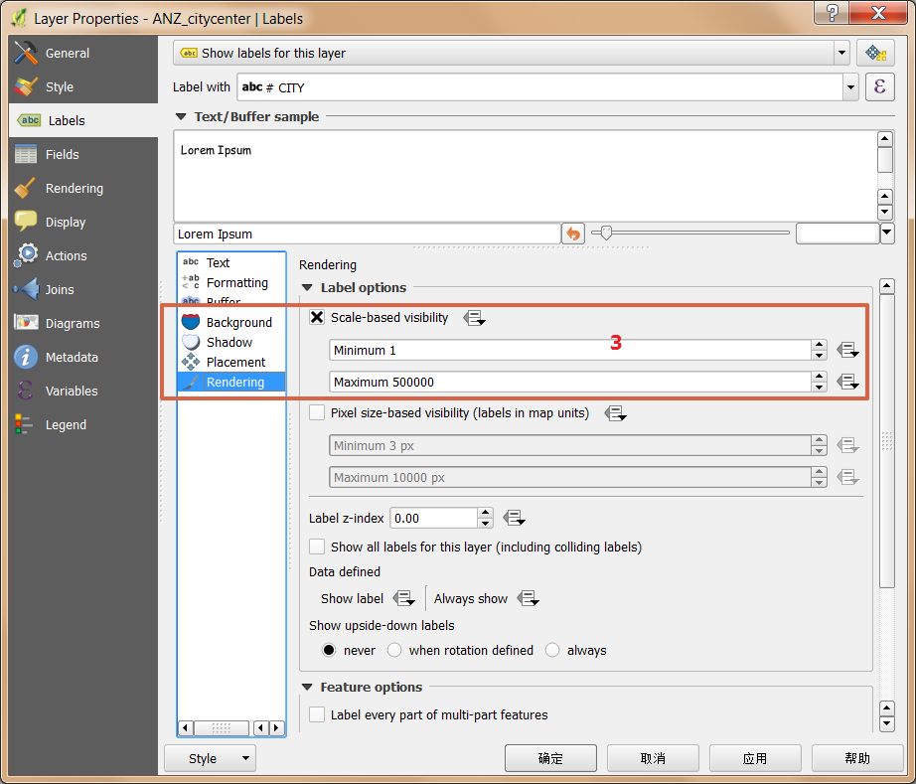
Properties – LABLE

Slide 18
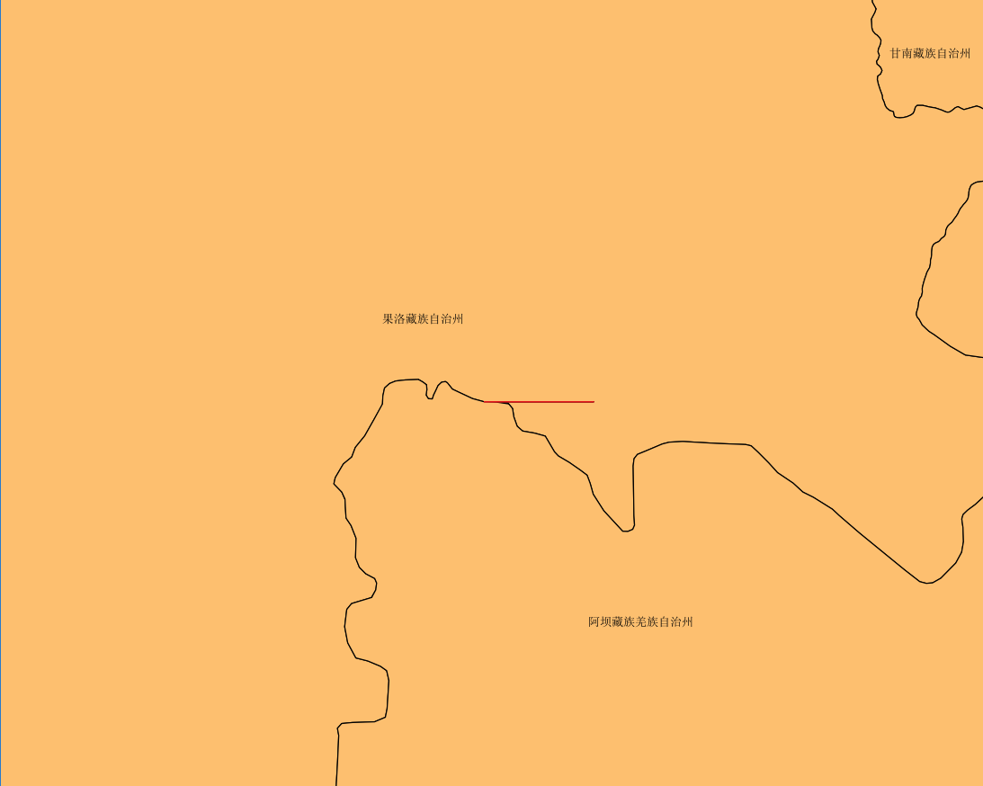
Example
How to find the city boundary geometry gaps?
Input: RDF data
Output: The city geometry gaps

Slide 19
Example -- Basic IDEA
Extract city boundary from rdf
Merge all city boundary to get the country boundary
Calculate difference set between country and city boundary
The difference set is the city geometry gaps

Slide 20
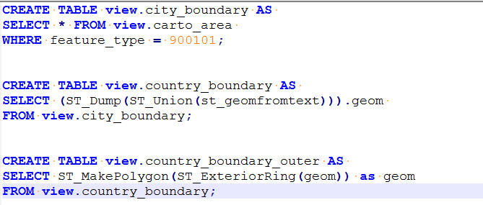
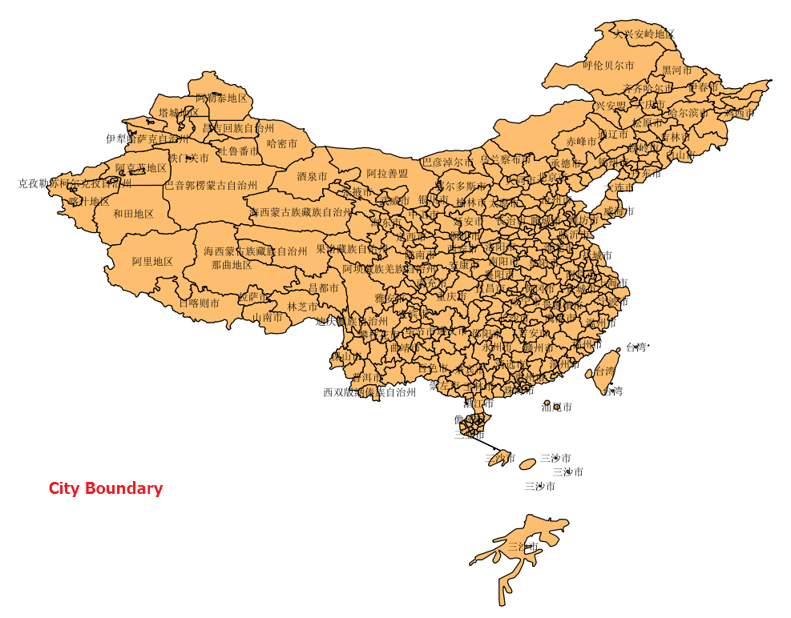
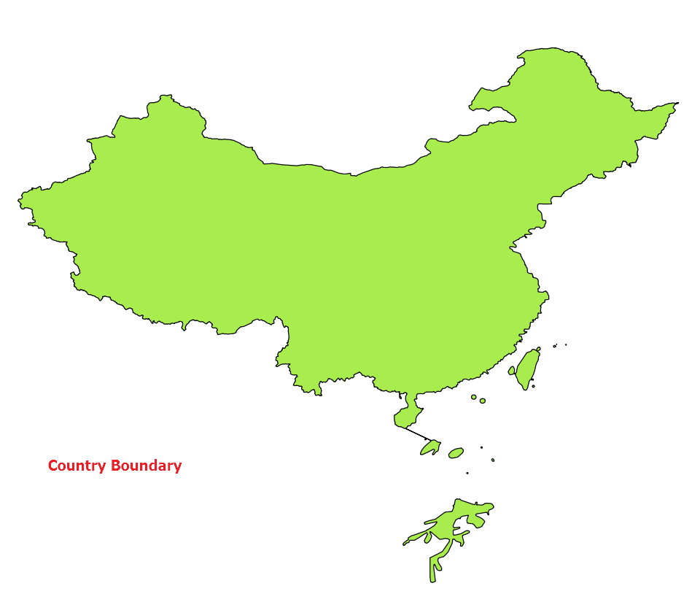
Example -- Using POSTGIS WITH QGIS

Slide 21
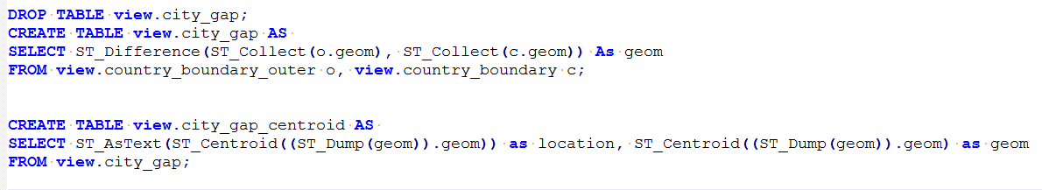
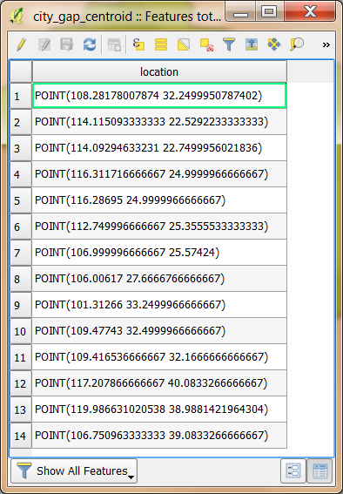
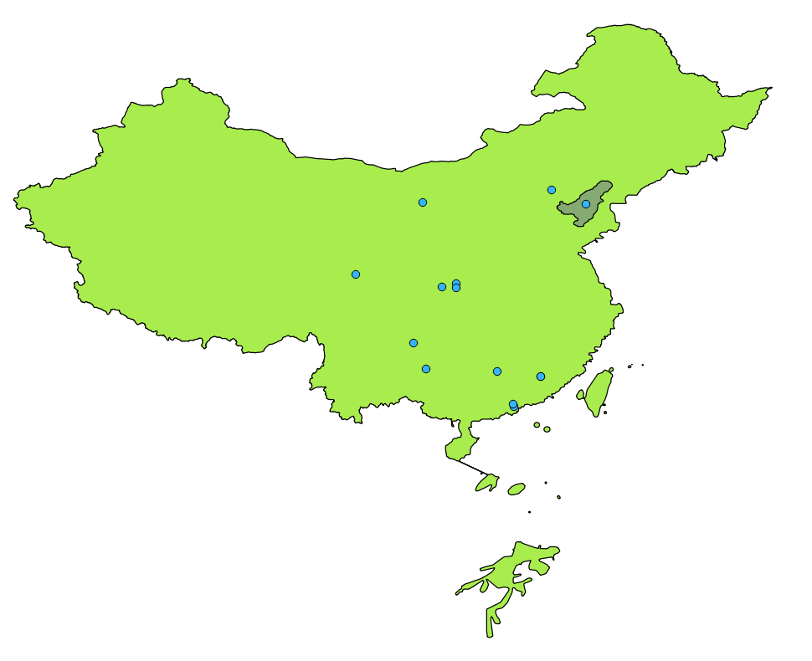
Example -- Using POSTGIS WITH QGIS

Slide 22
Q & A

